Slide 1

Swan_soundbar_
Rib cutting guide
ALT Co., Ltd.
Issued Date
Issued by
2021.10.27
SH, SON
Ver.1.0

Slide 2
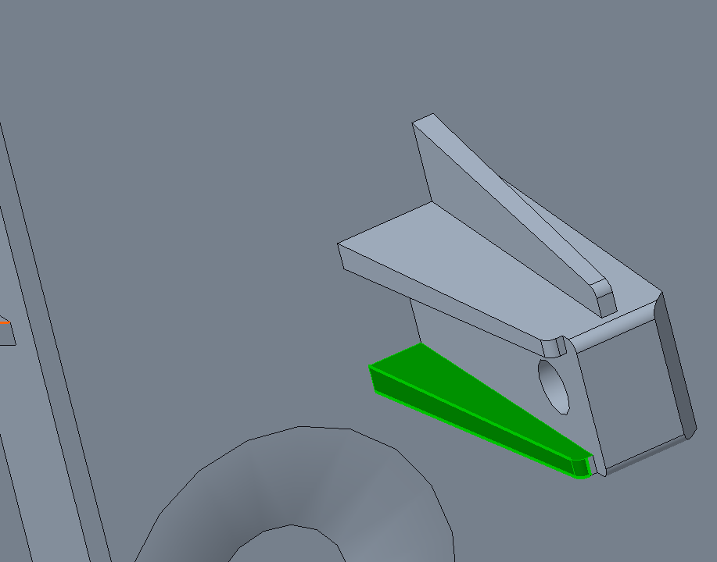
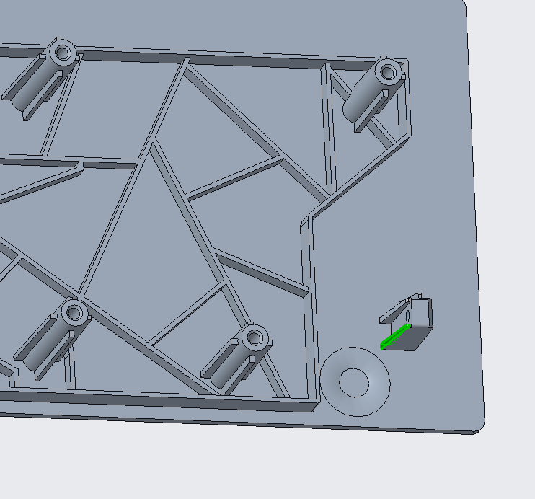
For Side LED FFC connector
  This rib have to cut until Side LED change or Top housing change
  Due to collision with FFC connector

Slide 3
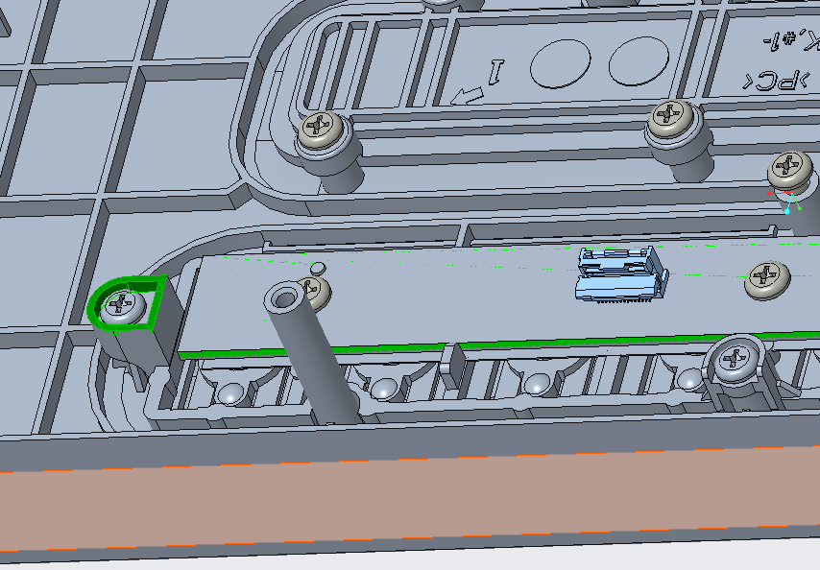
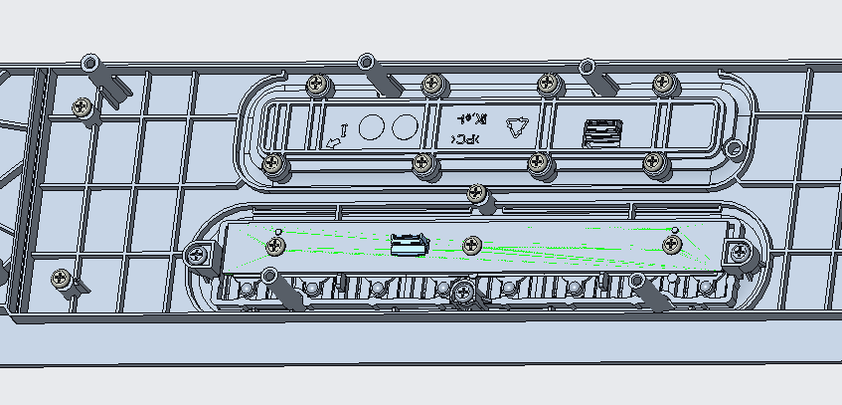
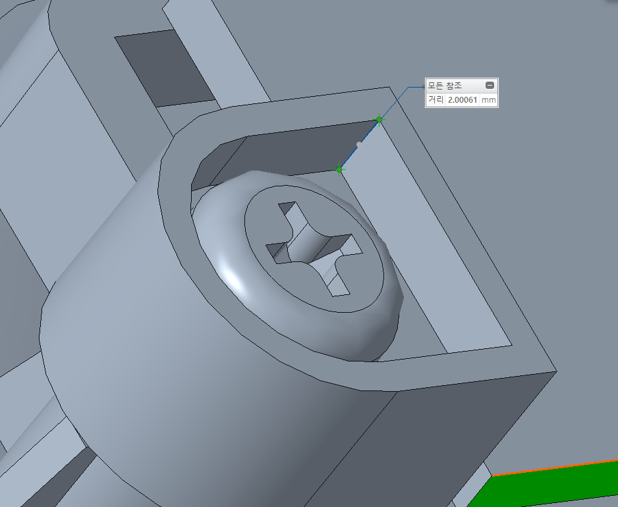
For Amp board inductor
  This rib have to cut until new amp board applied
  Due to collision with amp board inductor, inductor may broken.
  2mm Rib can be cutting,

Slide 4
End of Documents

